Slide 1


K.RAMAKRISHNAN COLLEGE OF TECHNOLOGY
(AUTONOMOUS)
IoT BASED SMART CLASSROOM AUTOMATION USING ARDUINO
PRESENTED BY : UNDER THE GUIDANCE OF
Abitharan S (811718105003) Mr.V. Suresh Kumar M.E.,
Balaji J (811718105051) Assistant Professor,
Prakash R (811718105030) Dept. of EEE.

Slide 2
PRESENTATION OVERVIEW
Abstract
Objective
Literature survey
Existing system
Block diagram of existing system
Disadvantages of existing system
Proposed system
Block diagram of proposed system
Explanation of proposed system
Advantages of proposed system
Simulation Model and Output
Hardware Model and output
Snapshot of Hardware model
Reference

Slide 3
ABSTRACT
Smart classroom is the representative of the modern teaching. With the advent of modern technology it becomes easier for the students as well as teachers to perform their task more efficiently.
With the aid of modern technology it has become easier for the students and teachers across the world to get a good grasp of the theoretical as well as practical knowledge.

Slide 4
OBJECTIVE
This project has four objectives:
The first objective of the project is to automatically take attendance from students using RFID and record attendance.
The second objective is to automatically control the fan and lights. The idea is to plant several sensors around the classroom and give a calculated feedback to the response these sensors receive.
The third objective is to erase the blackboard and rolled out the projector screen automatically.
The last objective is to be overall cost effective.

Slide 5
LITERATURE SURVEY 1
Author: A. Gupta, P. Gupta and J. Chhabra,
Title: "IoT based power efficient system design using automation for classrooms," 2015 Third International Conference on Image Information Processing (ICIIP), 2015.
Abstract: The proposed system works on automation, so that the electrical devices and switches can be remotely controlled and monitored without any human intervention.

Slide 6
LITERATURE SURVEY 2
Authors: F. Chang, H. Huang and L. Chu,
Title: "Learning the Classroom Automation Preferences with Low User Intervention," 2020 IEEE 2nd Global Conference on Life Sciences and Technologies (LifeTech), 2020.
Abstract: There are researches on how to incorporate the IoT technology into the pedagogy.

Slide 7
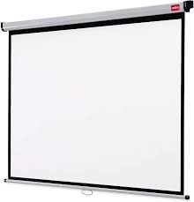




PROBLEM IDENTIFICATION
Opened Door & Windows
Projector Screen Roll Down
Erasing Board
Attendance
Fan & Lights ON

Slide 8
EXISTING SYSTEM
Sensors
Automatic Light
Microcontroller
Relay
Automatic Fan
Automatic Attendance System

Slide 9
DISADVANTAGES OF EXISTING SYSTEM
Time consuming
Relatively high cost
Contains minimum number of automated systems
Students and teachers will get disturbed
Electricity is wasted dud to carelessness

Slide 10
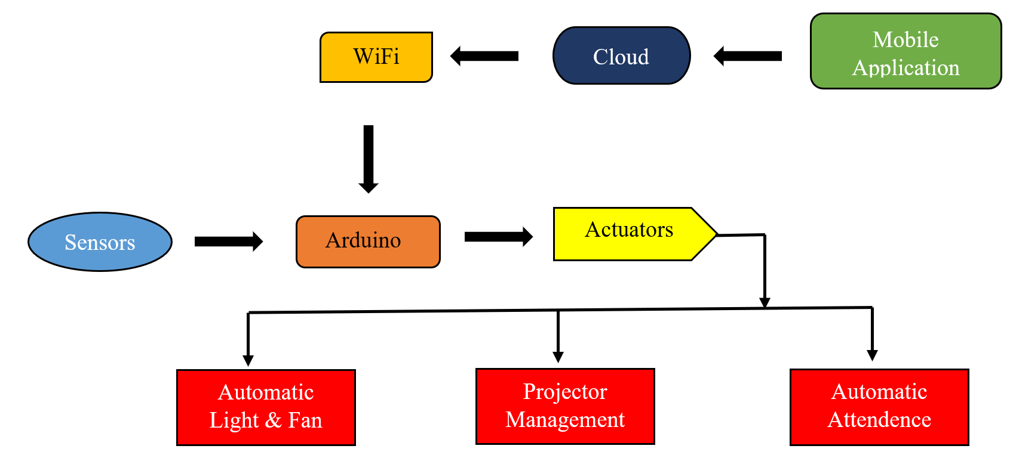
PROPOSED SYSTEM

Slide 11
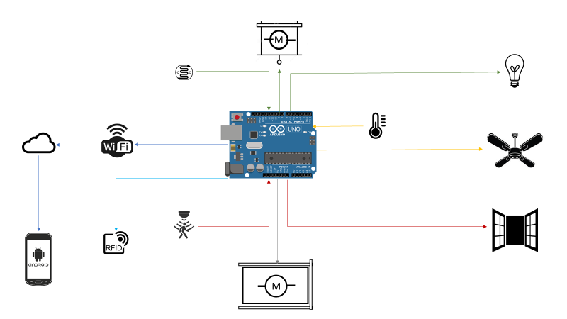
EXPLANATION OF PROPOSED WORK

Slide 12
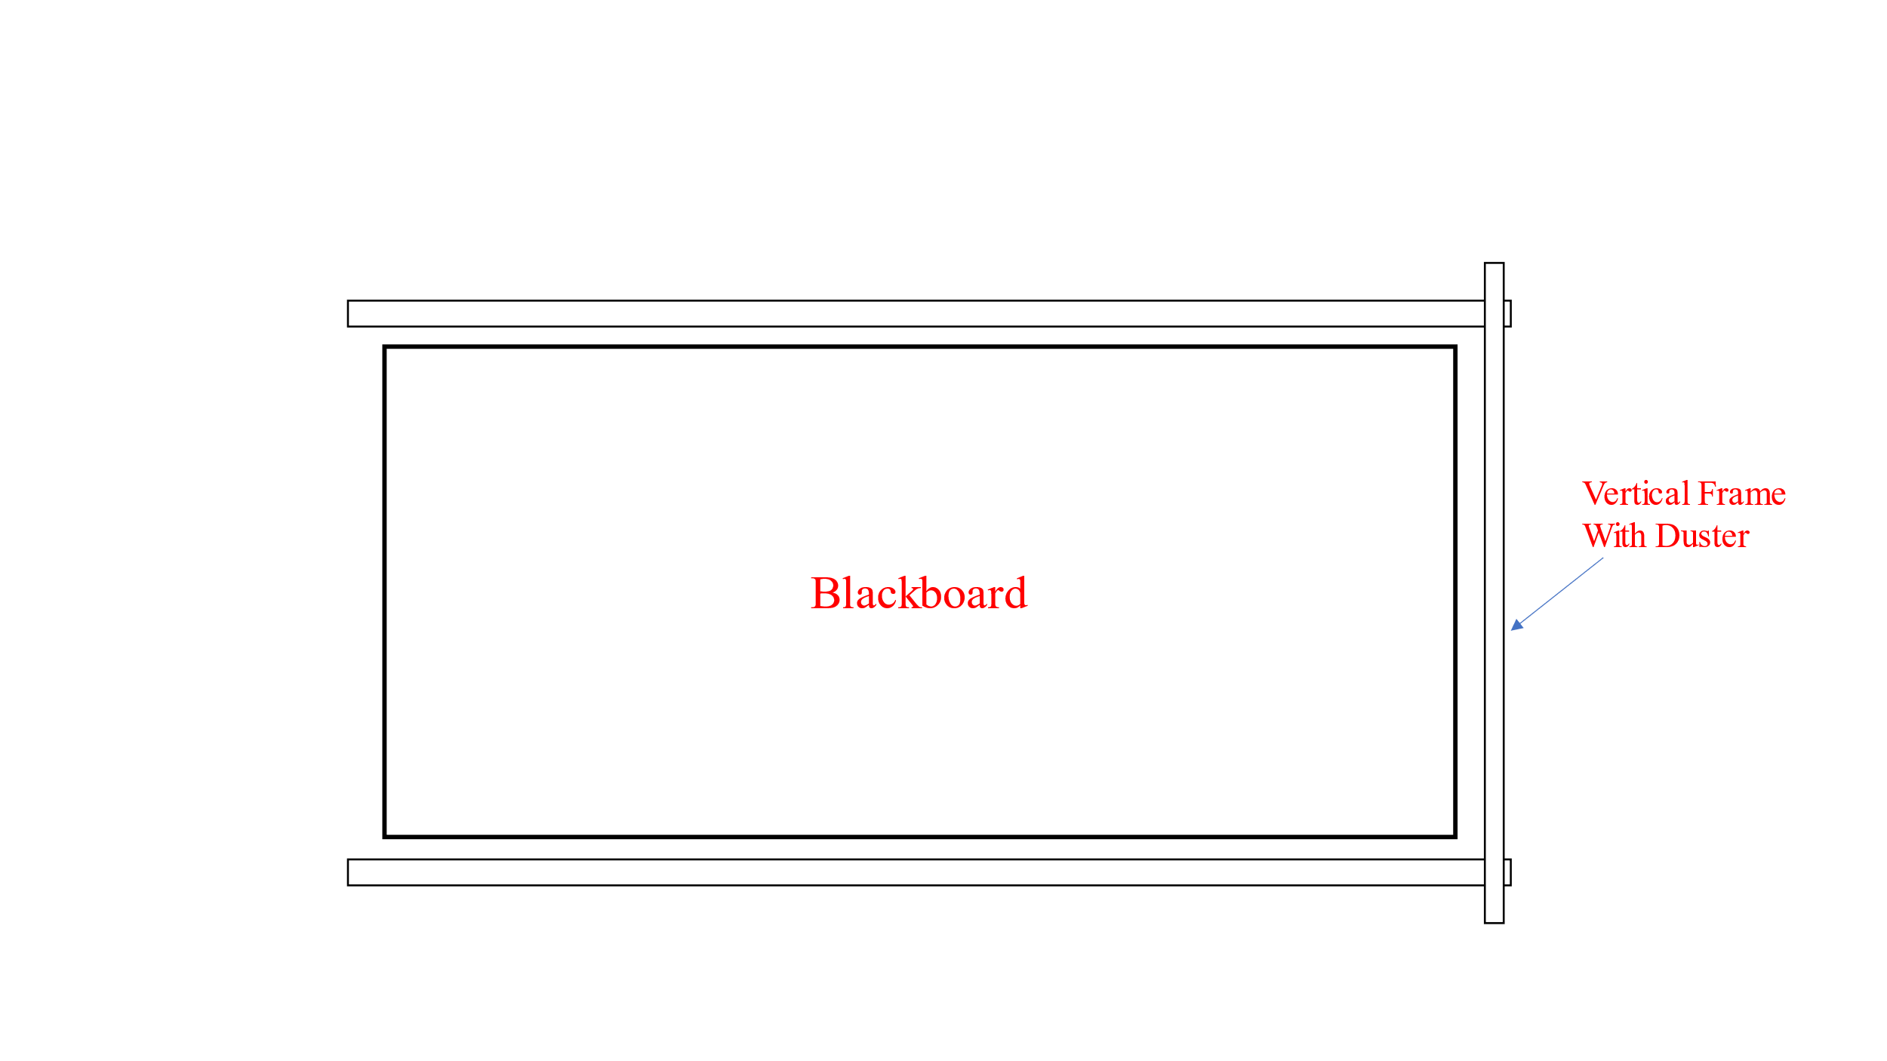
Blackboard Erasing System

Slide 13
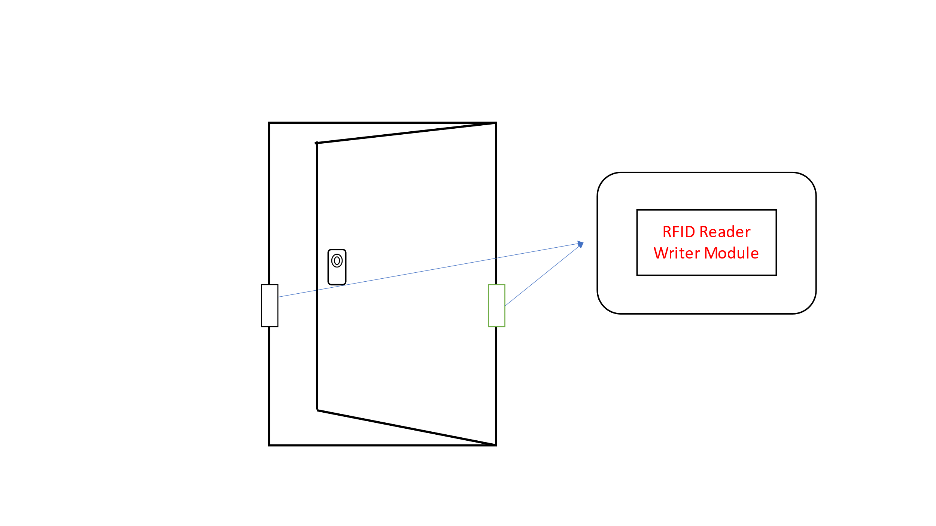
Automatic Attendance System

Slide 14
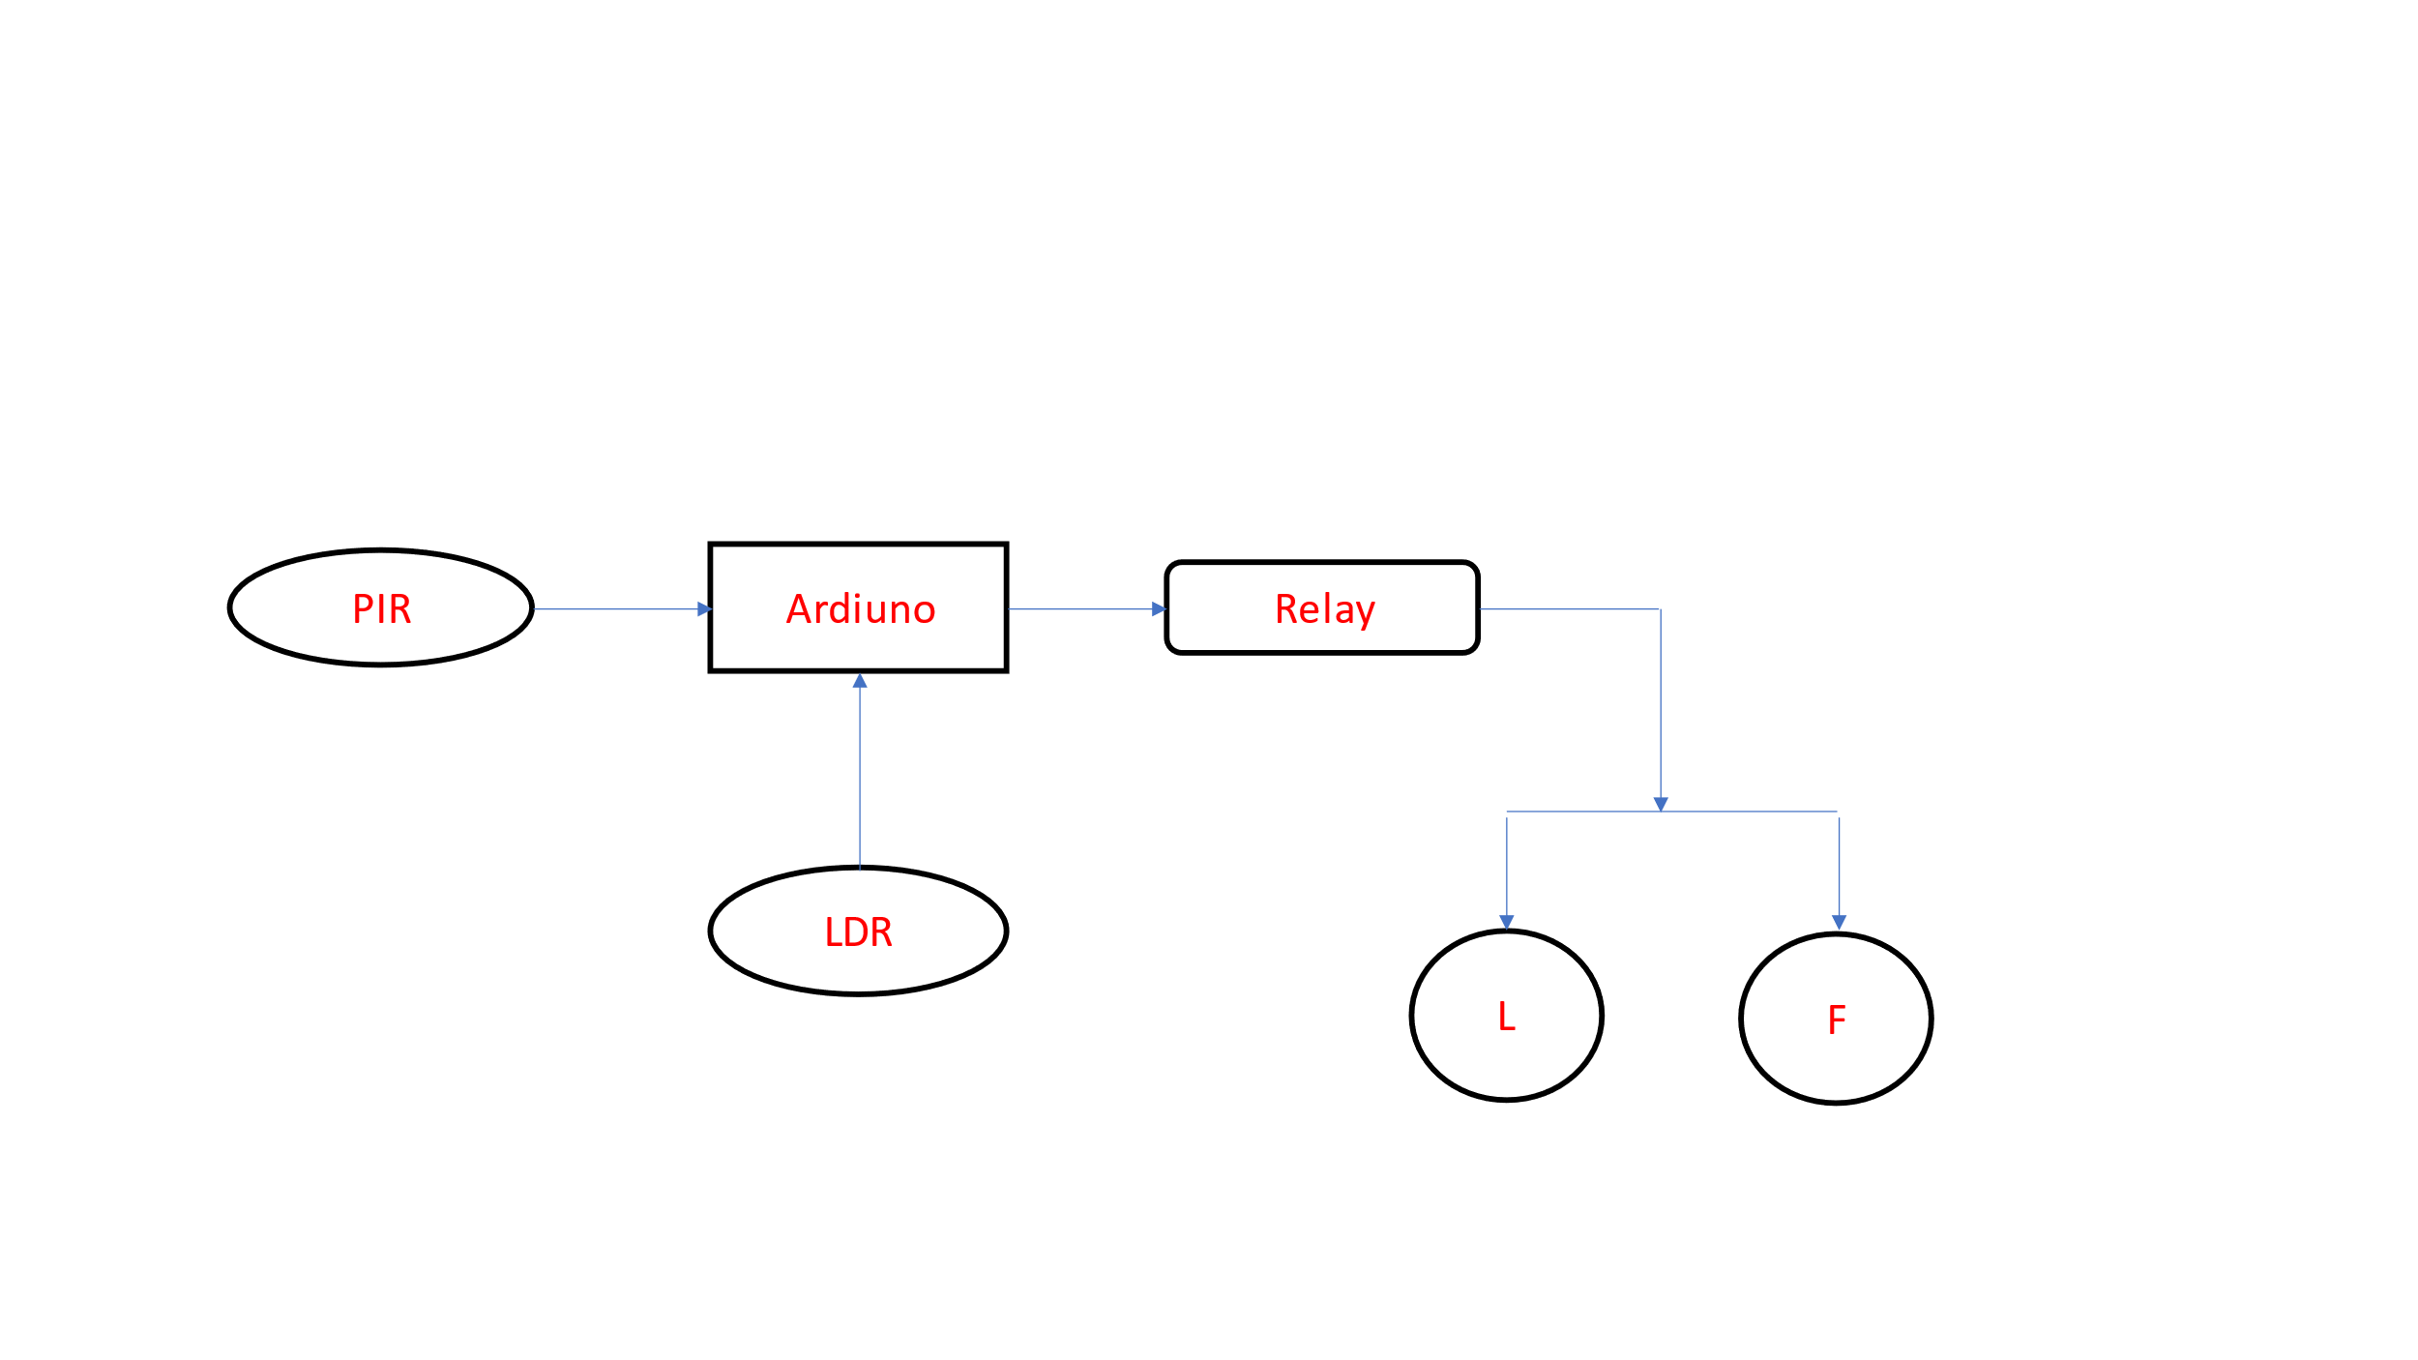
Automatic Fan and Light Controlling System

Slide 15
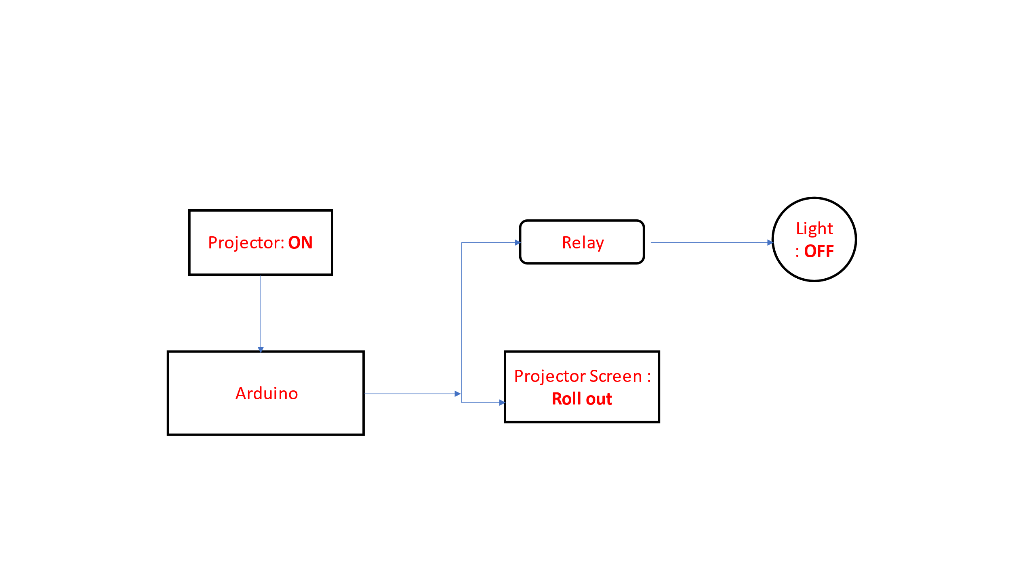
Automatic Projector Management System

Slide 16
ADVANTAGES OF PROPOSED SYSTEM
Integrated systems with Minimal Cost
User friendly Interface
Easily reprogrammable
Students and teachers can concentrate on lecture
Improvised energy saving

Slide 17



HARDWARE AND SOFTWARE REQUIREMENT
Apparatus
Arduino
Relay
PIR Sensor
Temperature Sensor
LDR Sensor
Servo Motors and DC Motors
RFID Reader Writer Modules & Tags
Specifications
UNO r3
5V,12mA
4.5-12 V,3-7m
LM35
3.3-5 V
1.6 Kg-cm,4.8V,12V
13-26mA ,DC 3.3V

Slide 18
HARDWARE MODEL AND OUTPUT
Arduino UNO | RFID RC522
PIN 10 | SDA
PIN 13 | SCK
PIN 11 | MOSI
PIN 12 | MISO
NC | IRQ
GND | GND
PIN 9 | RST
3.3 V | 2.2 V
RFID RC522 Interface with ARDUINO UNO R3

Slide 19
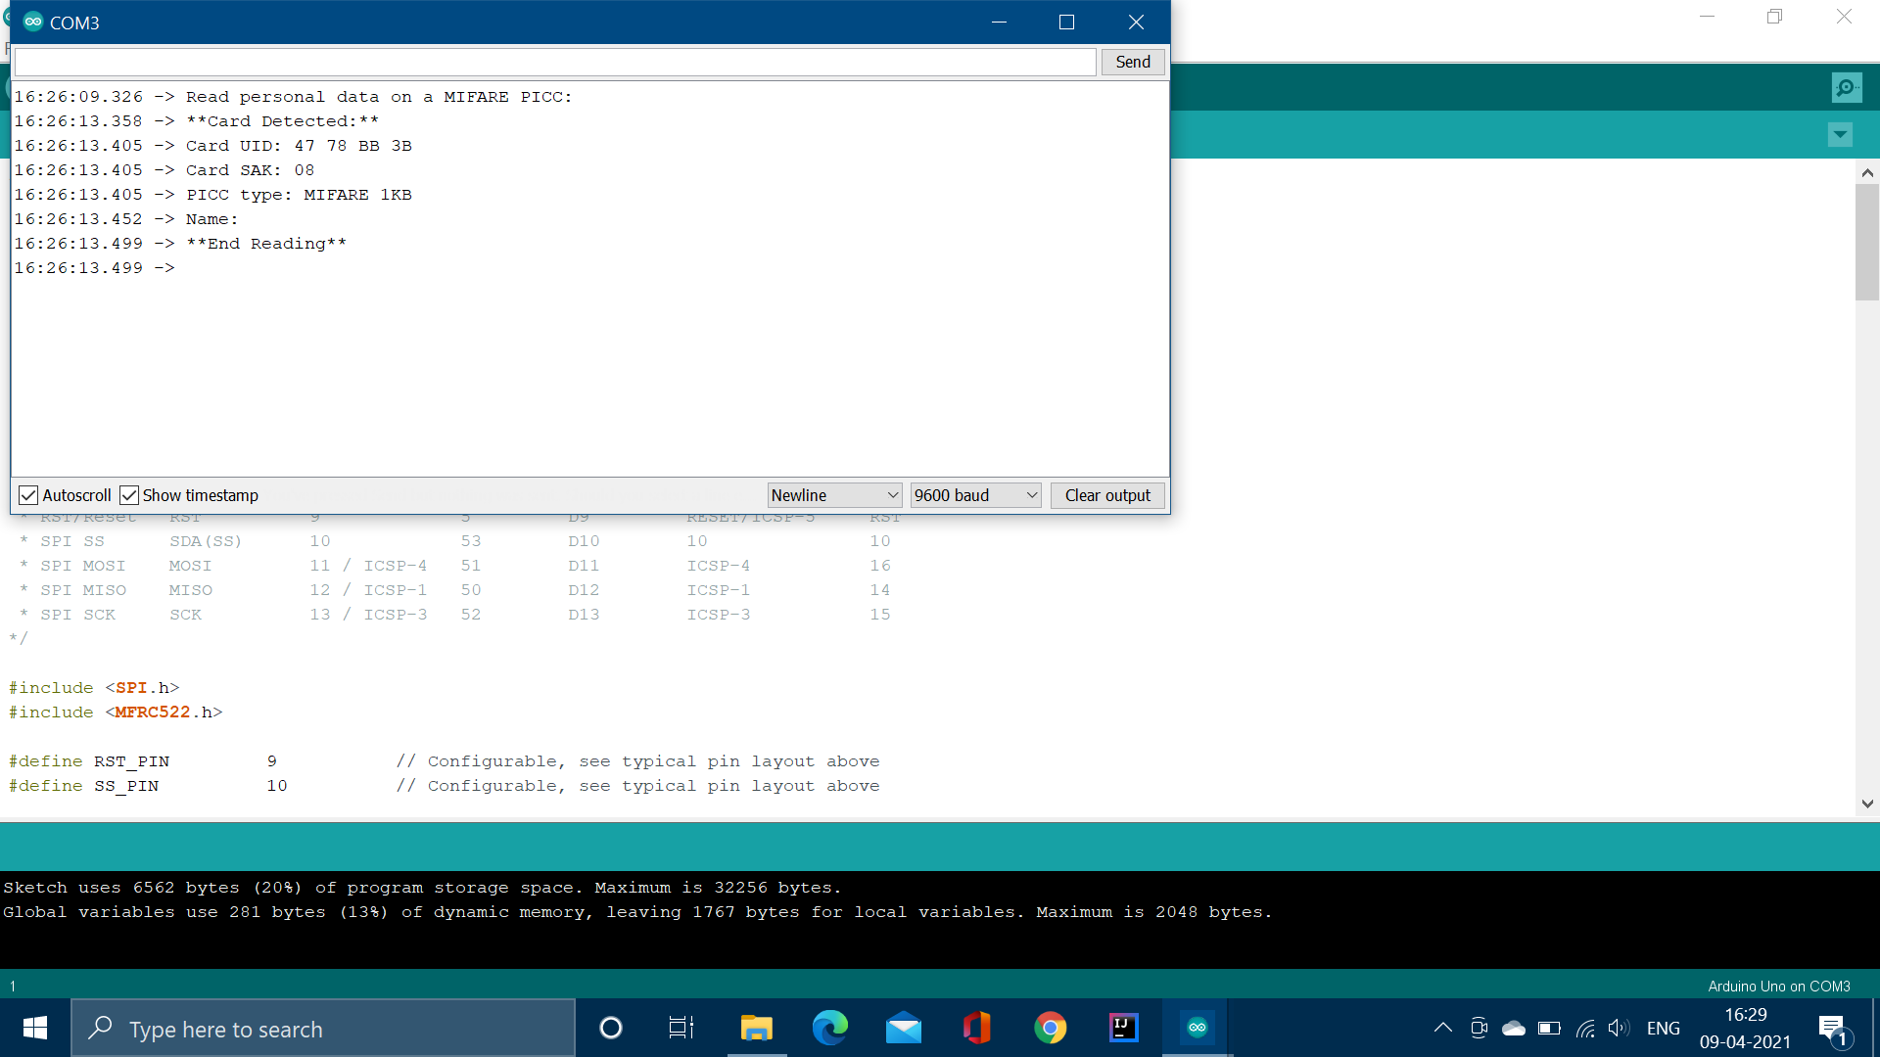
Output for Attendance System using ARDUINO IDE

Slide 20
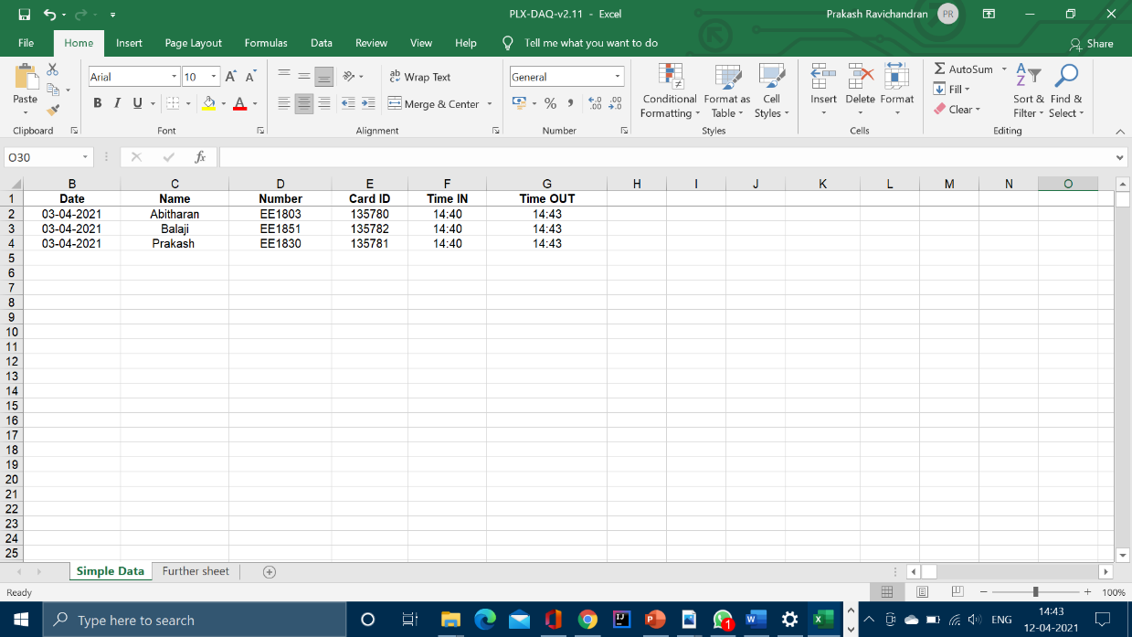
Output via Excel sheet

Slide 21
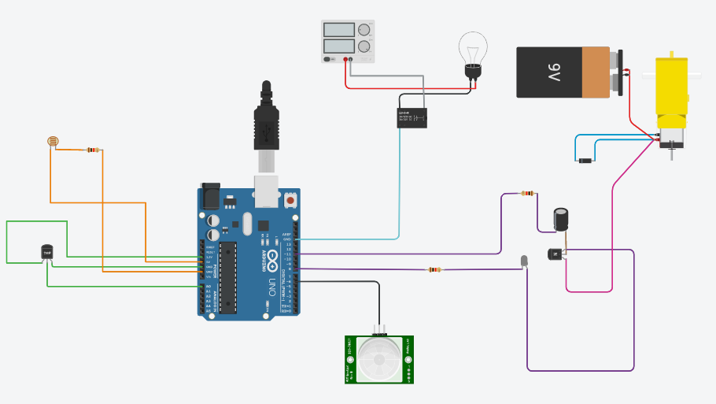
HARDWARE MODEL AND OUTPUT
Circuit for Automatic Fan & Light Control Using TINKERCAD

Slide 22
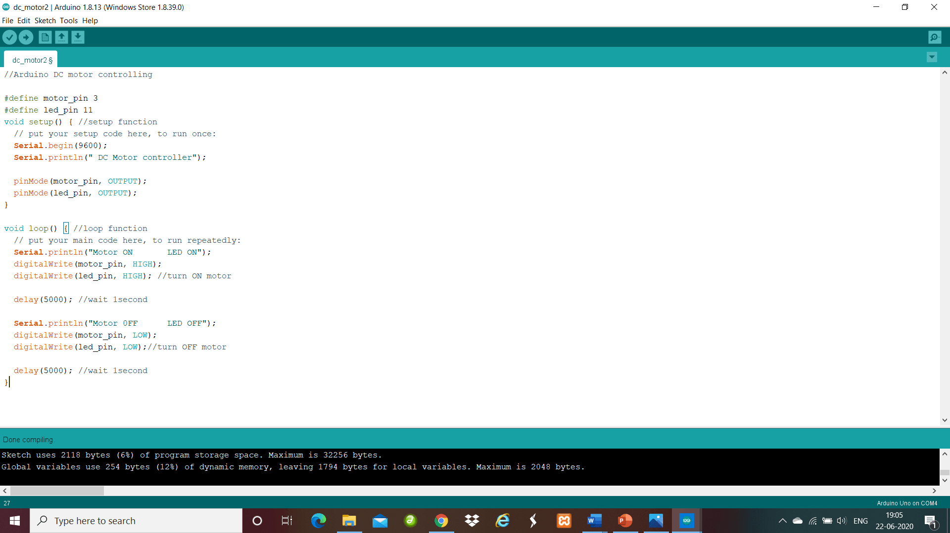
Code for Automatic Fan And Light Control using ARDUINO IDE

Slide 23
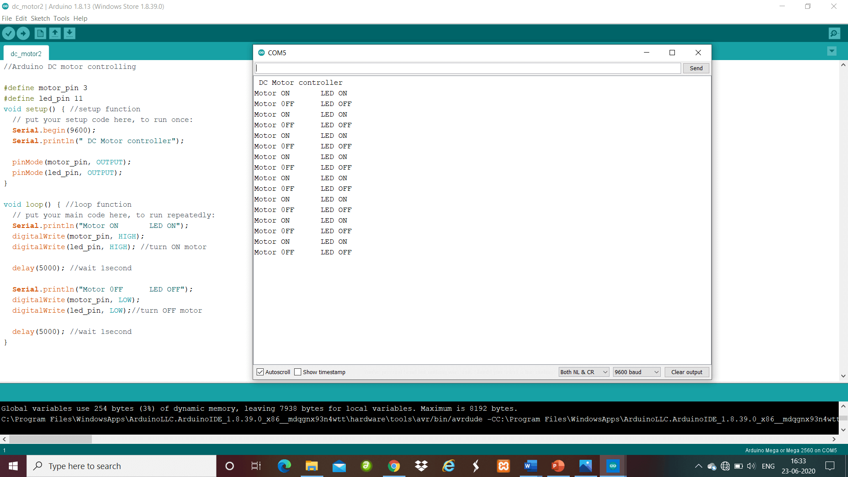
Output for Automatic Fan And Light Control using ARDUINO IDE

Slide 24
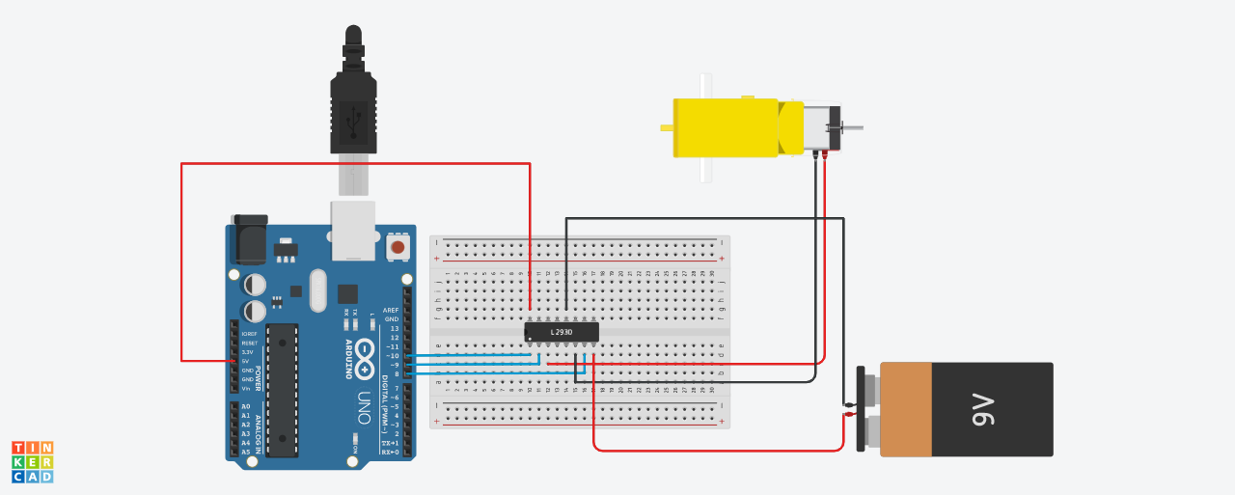
HARDWARE MODEL AND OUTPUT
Circuit for DC Motor Control using TINKERCAD

Slide 25
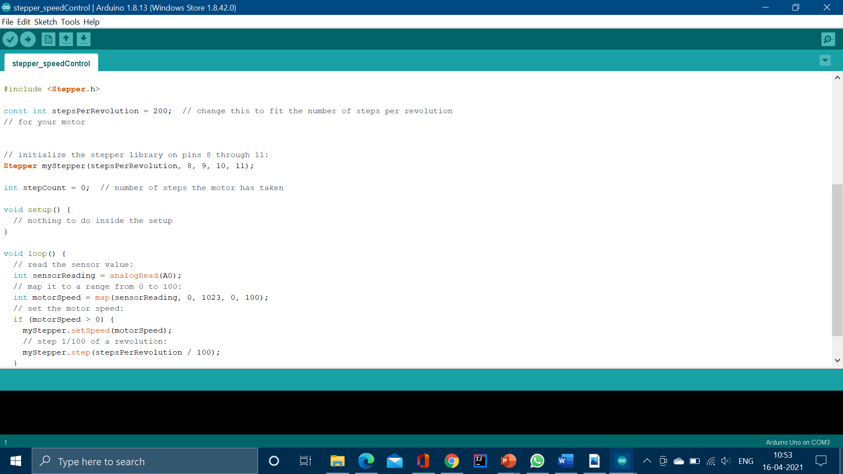
Code for DC Motor Control using ARDUINO IDE

Slide 26
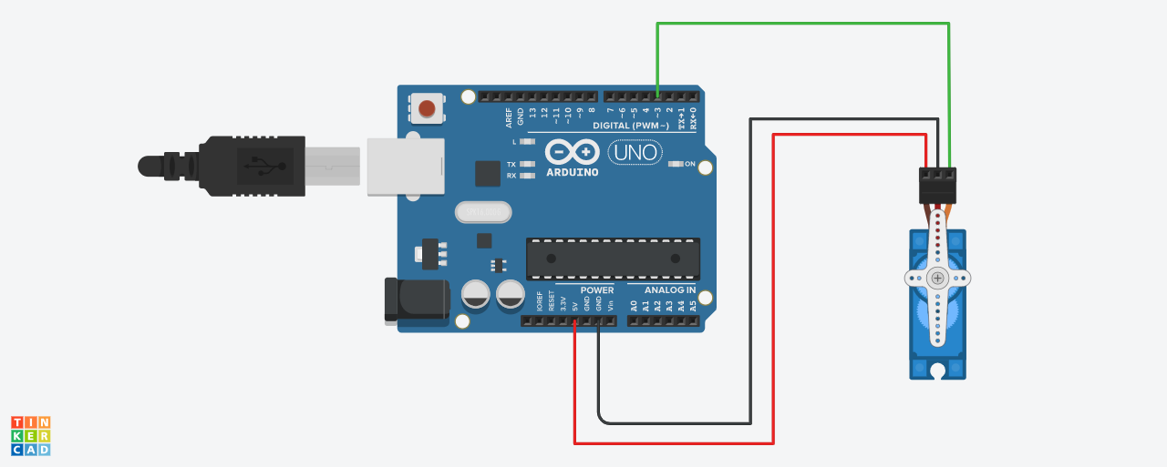
HARDWARE MODEL AND OUTPUT
Circuit for Servo Motor Control using TINKERCAD

Slide 27
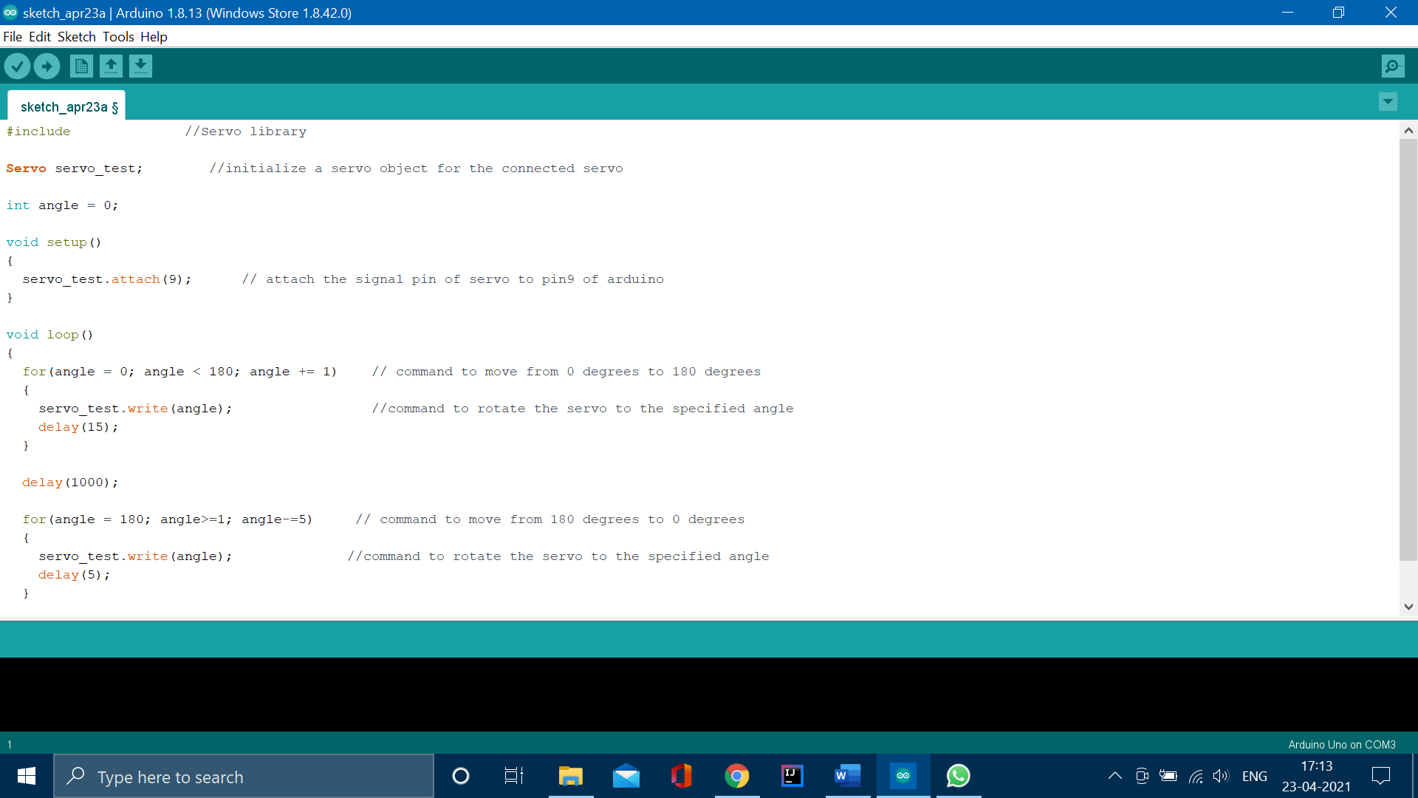
Code for Servo Motor Control using ARDUINO IDE

Slide 28
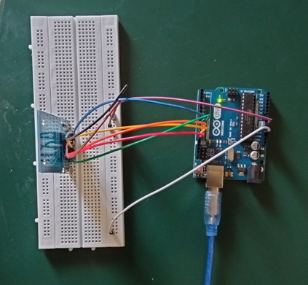
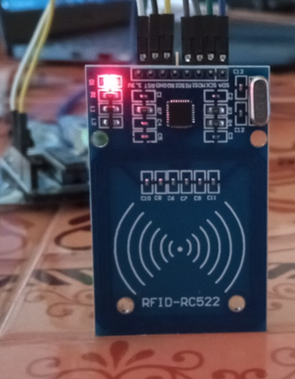
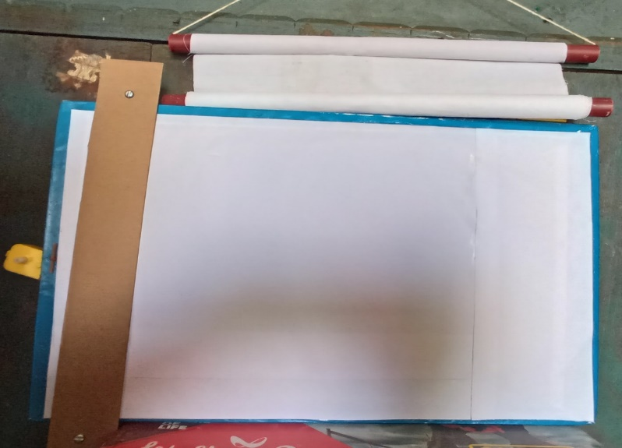
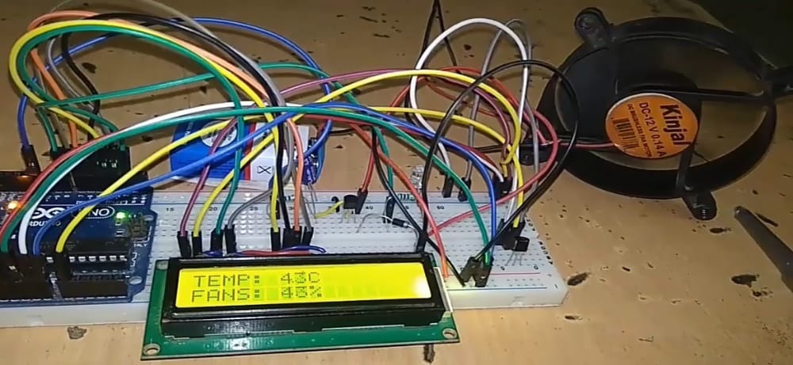
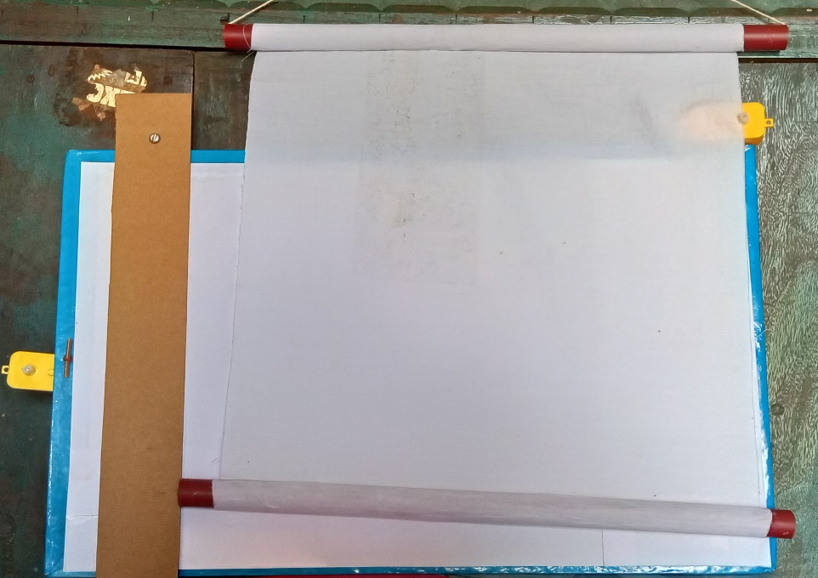
SNAPSHOT OF HARDWARE MODEL

Slide 29
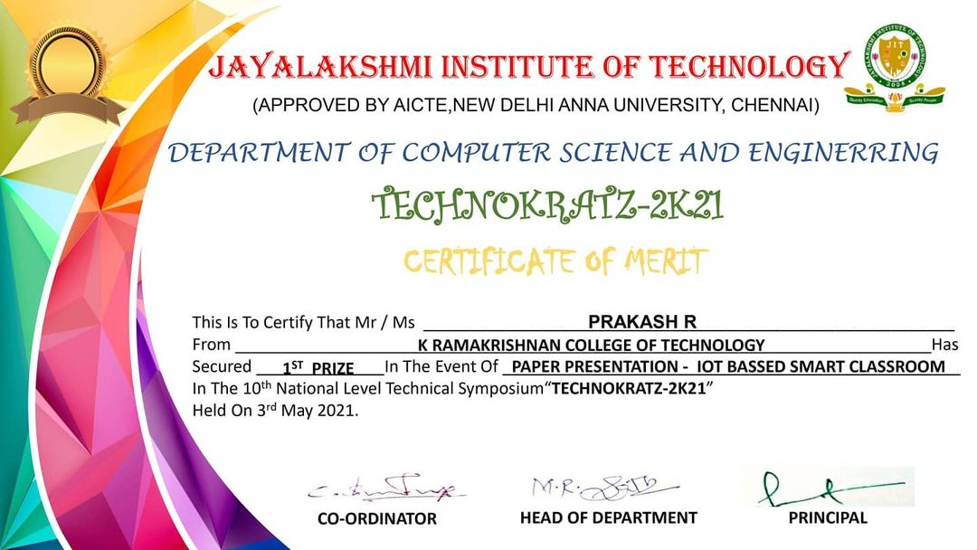
LIST OF PUBLICATIONS
This is a certificate for Present our paper in TECHOKRATZ 2K21.

Slide 30
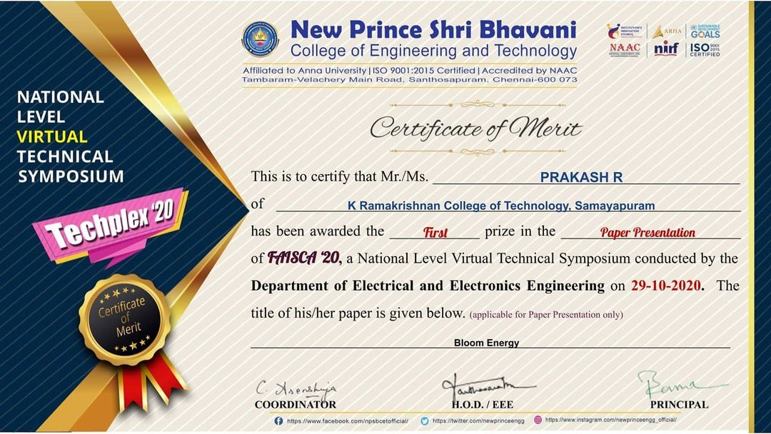
LIST OF PUBLICATIONS
This is a certificate for Present our paper in FAISCA 2K21.

Slide 31
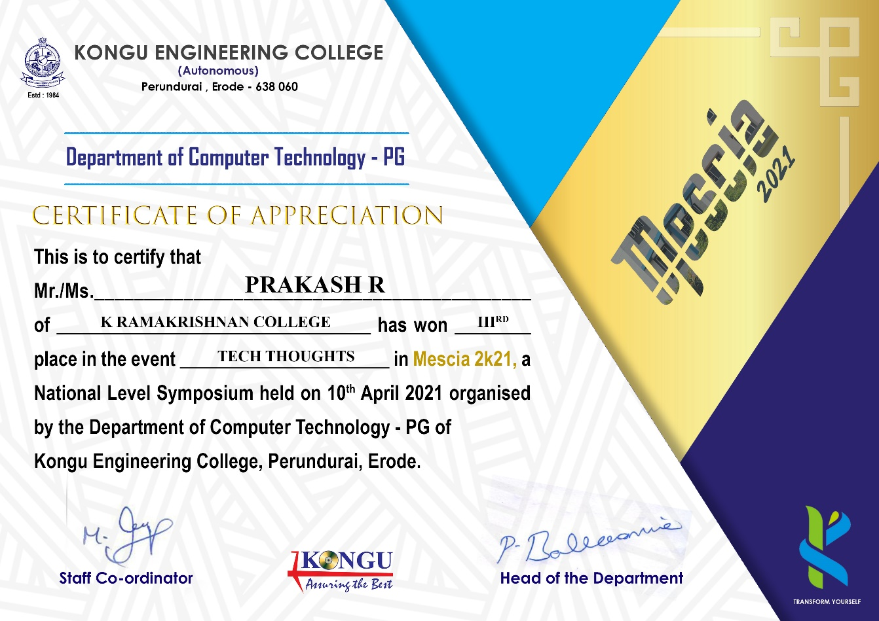
LIST OF PUBLICATIONS
This is a certificate for Present our paper in MESCIA 2K21.

Slide 32

LIST OF PUBLICATIONS
This is a certificate for Present our paper in ZREYAS 2K21.

Slide 33
REFERENCE
Abhishek N Vaghela,Bhavin D Gajjar,Subhash J Patel.” Automatic switch using PIR sensor”, in 2017 International Journal of Engineering and Research| Volume 5, Issue 1 | ISSN: 2321-9939
2. Imam-Ul-Ferdous , A.H.M Fazle Elahi, “Development of an automatic board cleaning system using microcontroller” in International Conference on Mechanical, Industrial and Energy Engineering 2014 26-27 December, 2014
3. S.B.Chaudhari, Saurabh Khulpe, Pratik Patki, Kaustubh Kale , Dinesh Malage, “ Classroom automation using voice commands”, International Journal of Advance Engineering and Research Development, Volume 3, Issue 3, March -2016
4. Asit Baran Chanda, “Hardware of electronic notice board”, International Journal of Engineering and Research| Volume 5, Issue 1 | ISSN: 2321-9939
Karthik Krishnamurthi, S. Irudaya Mary, B. N. Sumalatha, Adler Pereira, “Fringerprint based attendance system”, International Journal of Advanced Research in Computer andCommunication Engineering, Vol. 4, Issue 3, March

Slide 34
THANK YOU !

